Slide 1


Git & GitHub
By -
Reetam Dey Anshumohan Acharya

Slide 2
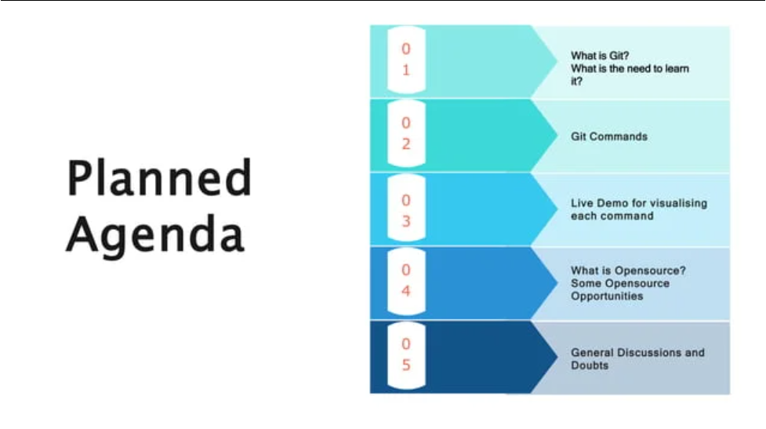

Slide 3
INSTALLATION GUIDE
Git - Downloading Package (git-scm.com)
Windows User ??
Oh ! Or is it MACOS ??
Git - Downloading Package (git-scm.com)
Well , if it’s Linux / Unix --
UBUNTU : sudo apt install git
OR
FEDORA : sudo yum install git

Slide 4

“Let’s Git init”

Slide 5

Local Version Control System
A local copy is created in my own computer . All versions are stored in folder , sub-folders or
A database. That’s the user’s choice.
But what if I want to collaborate with people ??
Or what if my computer stops working ??

Slide 6
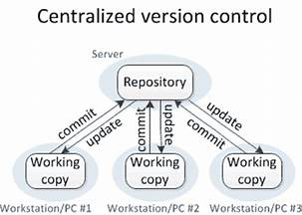
Centralised Version Control System (CVCS)
A Centralized Version Control System , Here we have a server and a client. The server is the master repository that contains all of the versions of the code. To work on any project, firstly user or client needs to get the code from the master repository or server. So the client communicates with the server and pulls all the code or current version of the code from the server to their local machine.

Slide 7
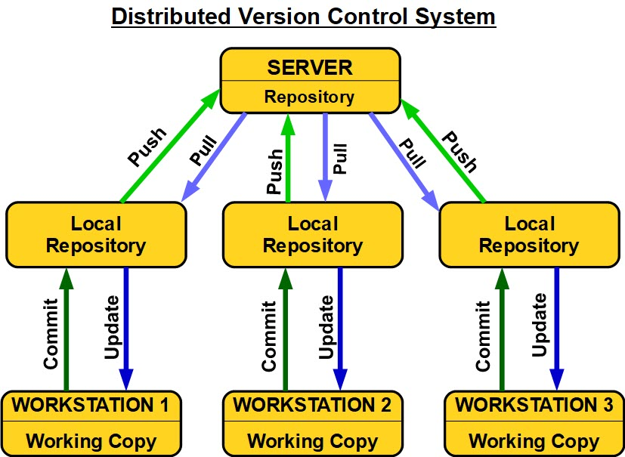
Distributed Version Control System (DVCS)
In distributed version control most of the mechanism or model applies the same as centralized. The only major difference you will find here is, instead of one single repository which is the server, here every single developer or client has their own server and they will have a copy of the entire history or version of the code and all of its branches in their local server or machine.

Slide 8
Git and Github
There are many words to define git, but it is an open-source distributed version control system in simpler words.
Why is git needed?
When a team works on real-life projects, git helps ensure no code conflicts between the developers. Furthermore, the project requirements change often. So a git manages all the versions. If needed, we can also go back to the original code. The concept of branching allows several projects to run in the same codebase.
GitHub is a Git repository hosting service that provides a web-based graphical interface. It is the largest community in the world. Whenever a project is open-source, that particular repository gains exposure to the public and invites several people to contribute.

Slide 9
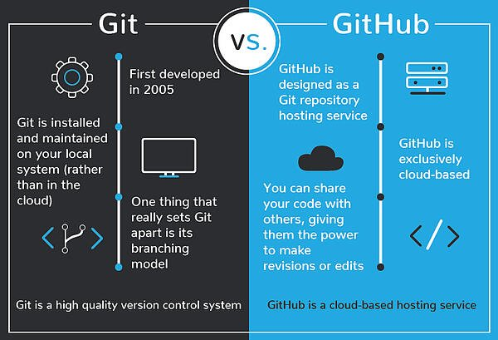

Slide 10
Advantages of Git
Speed
Simplicity
Fully Distributed
Excellent support for parallel development, support for hundreds of parallel branches.
Integrity

Slide 11
Git commands
Here is a list of most essential Git commands that are used daily.
Git config command
Git clone command
Git add command
Git commit command
Git status command
Git push Command
Git pull command
Git Branch Command
Git Merge Command
Git log command
But there are many more commands..Let’s start…!

Slide 12
For new git users
Git supports a command called git config that lets you get and set configuration variables that control all facets of how Git looks and operates. $ git config --global user.name “GDSC IIIT KOTTAYAM“
$ git config --global user.email “gdsc@iiitkottayam.ac.in"
You can check your configuration settings :
$ git config -list

Slide 13
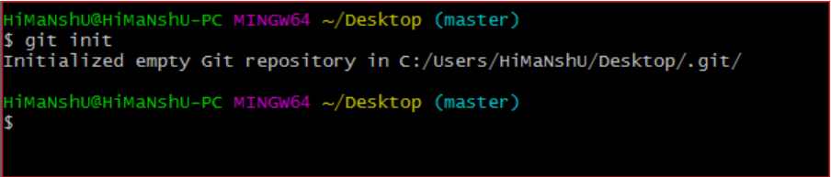
Git init
The git init command is the first command that you will run on Git. The git init command is used to create a new blank repository. It is used to make an existing project as a Git project.
$ git init
Example :

Slide 14
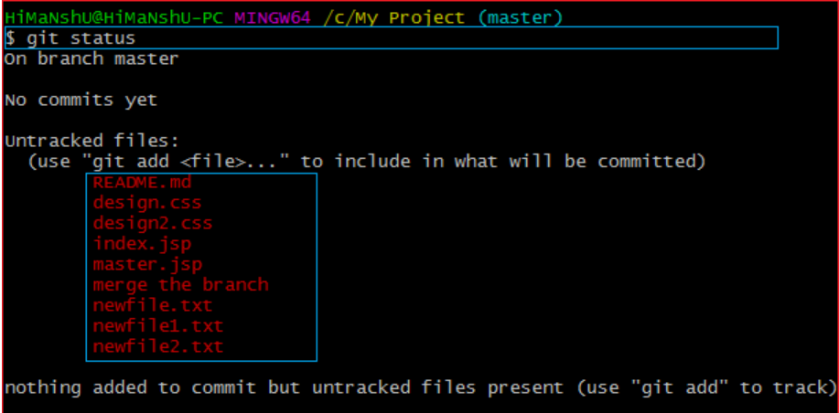
Git Status
We can list all the untracked files by git status command.
$ git status

Slide 15
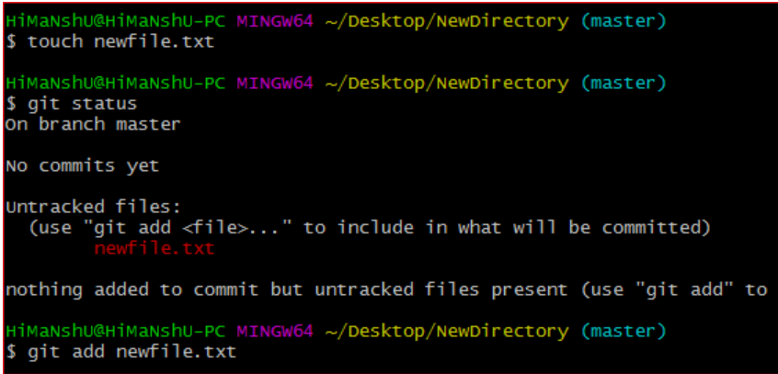
Git add
The git add command is used to add file contents to the index (Staging area) .This command updates the current content of the working tree to the staging area. It also prepares the staged content for the next commit. Every time we add or update any file in our project, it is required to forward updates to the staging area.
$ git add <File name>

Slide 16
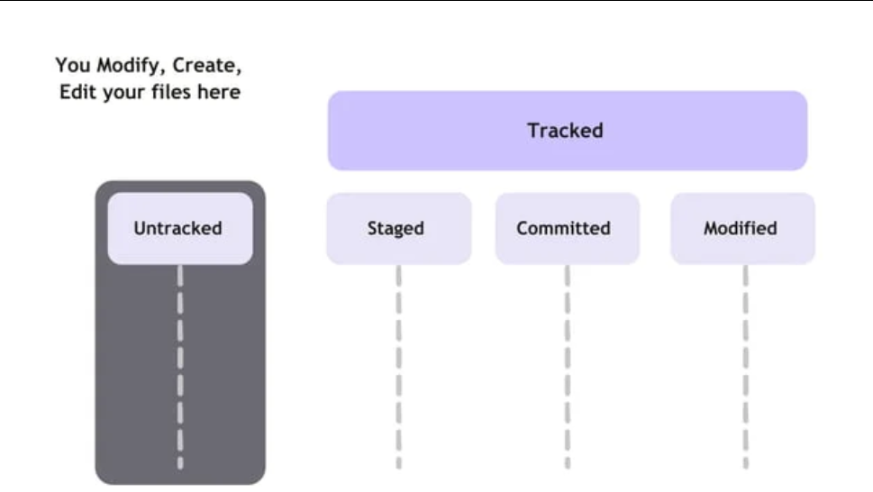

Slide 17
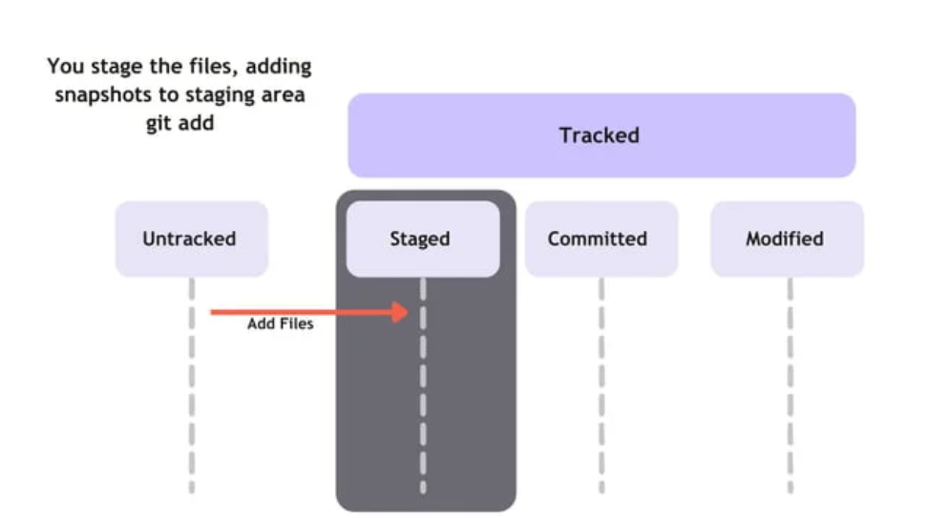

Slide 18
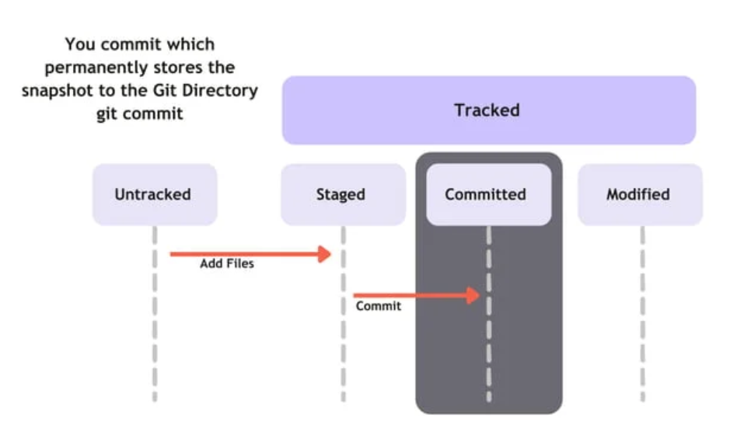

Slide 19
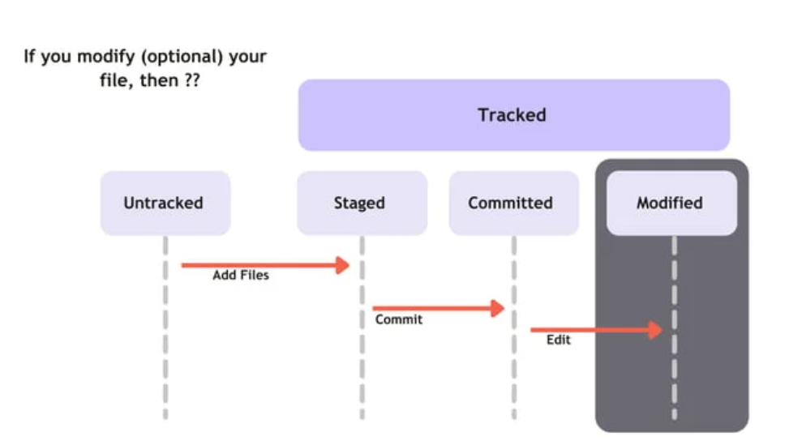

Slide 20
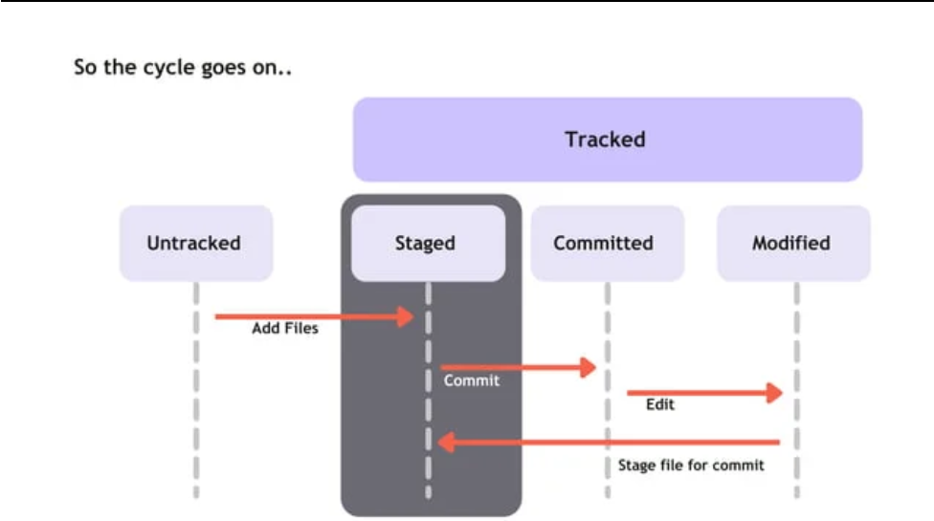

Slide 21
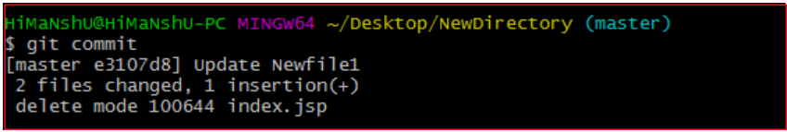
Git Commit
It is used to record the changes in the repository. It is the next command after the git add. Every commit contains the index data and the commit message.
Commits are the snapshots of the project. Every commit is recorded in the master branch of the repository. We can recall the commits or revert it to the older version. Two different commits will never overwrite because each commit has its own commit-id. This commit-id is a cryptographic number created by SHA (Secure Hash Algorithm) algorithm.
$ git commit -m <Committing Message>

Slide 22
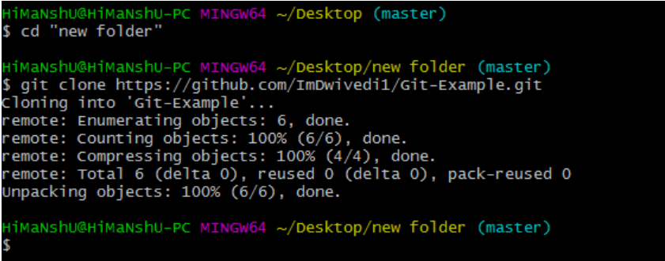
Git clone
In Git, cloning is the act of making a copy of any target repository. The target repository can be remote or local. You can clone your repository from the remote repository to create a local copy on your system.
$ git clone <repository URL>

Slide 23
Git ignore
In Git, the term "ignore" is used to specify intentionally untracked files that Git should ignore. It doesn't affect the Files that already tracked by Git. The file system of Git is classified into three categories:
Tracked:
Tracked files are such files that are previously staged or committed.
Untracked:
Untracked files are such files that are not previously staged or committed.
Ignored:
Ignored files are such files that are explicitly ignored by git. We have to tell git to ignore such files.
$ touch .gitignore

Slide 24
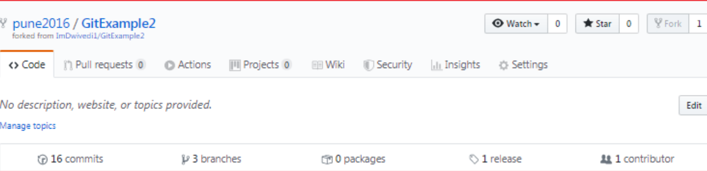
Git Fork
A fork is a rough copy of a repository. Forking a repository allows you to freely test and debug with changes without affecting the original project.
the forked repository looks like pune2016/GitExample2. At the bottom of the repository name, we can see a description of the repository. At the top right corner, the option fork is increased by 1 number.

Slide 25
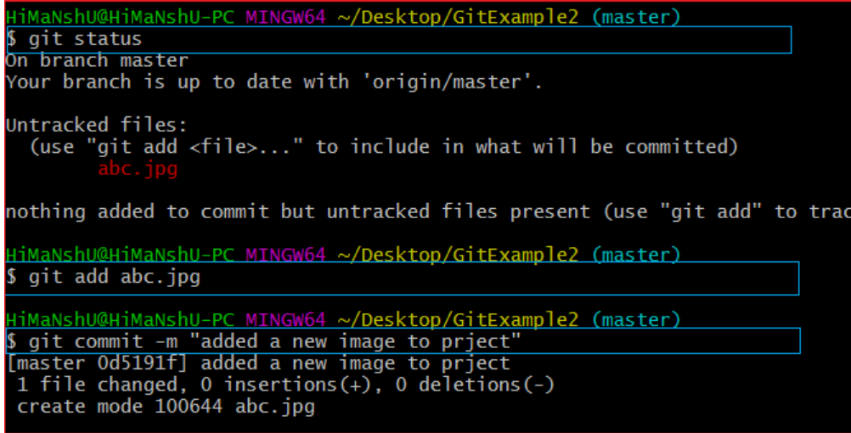
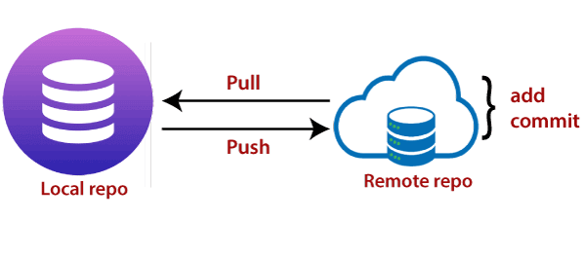
Git Push
The push term refers to upload local repository content to a remote repository. Pushing is an act of transfer commits from your local repository to a remote repository. Pushing is capable of overwriting changes; caution should be taken when pushing.

Slide 26
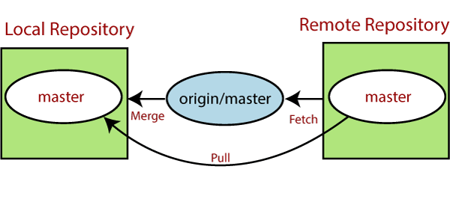
Git pull
The term pull is used to receive data from GitHub. It fetches and merges changes from the remote server to your working directory. The git pull command is used to pull a repository.
Pull request is a process for a developer to notify team members that they have completed a feature. Once their feature branch is ready, the developer files a pull request via their remote server account. Pull request announces all the team members that they need to review the code and merge it into the master branch.
$ git pull

Slide 27
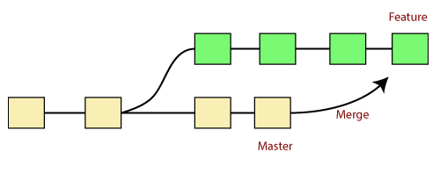
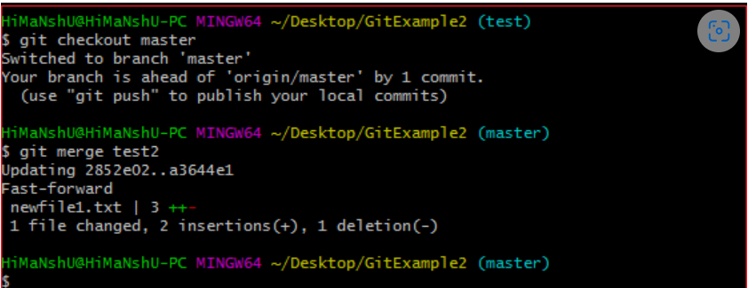
Git merge
In Git, the merging is a procedure to connect the forked history. It joins two or more development history together.
Generally, git merge is used to combine two branches.
$ git merge <branchname>

Slide 28
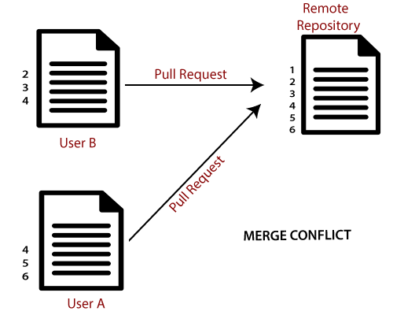
Merge conflicts
When two branches are trying to merge, and both are edited at the same time and in the same file, Git won't be able to identify which version is to take for changes. Such a situation is called merge conflict. If such a situation occurs, it stops just before the merge commit so that you can resolve the conflicts manually.

Slide 29
Git Cheat Sheet
Git Cheat Sheet – javatpoint
git-cheat-sheet-education (github.com)

